Slide 1


Lesson 9: Sentiment Analysis
Partly based on slides from Bing Liu and others
https://www.cs.uic.edu/~liub/FBS/Sentiment-Analysis-tutorial-AAAI-2011.pdf https://link.springer.com/article/10.1007/s10462-022-10144-1

Slide 2

Agenda
1
Introduction to SA
2
SA Tasks
3
SA Techniques
4
Challenges for SA
5
SA with Python

Slide 3
1
Introduction to
Sentiment Analysis

Slide 4


Sentiment Analysis
Computational study of opinions, sentiments, evaluations, attitudes,
appraisal, affects, views, emotions, subjectivity, etc., expressed in
text.
Text includes reviews, blogs, discussions, news, comments, feedback…
Also called Opinion mining

Slide 5
Sentiment Analysis Levels
Document level
Performed on an entire document
Assume the document holds only one polarity
Sentence level
Independently performed for each sentence.
Useful when the document contains a mix of sentiments
May be then aggregated to decide the sentiment per document.
Aspect level
Each sentence may contain multiple aspects
Goal: to assign polarity to each aspect
I bought an iPhone a few days ago. It is such a nice phone. The touch screen is really cool. The voice quality is clear too. It is much better than my old Blackberry, which was a terrible phone and so difficult to type with its tiny keys. However, my mother was mad with me as I did not tell her before I bought the phone. She also thought the phone was too expensive…

Slide 6
Basic Components of an Opinion
Aspect/Feature Level
Opinion targets: entities and their features/aspects
Touch screen, voice quality, price…of iPhone
Sentiments: positive and negative
Opinion holders: persons who hold the opinions
Myself, my mother
Time: when opinions are expressed
Few days ago
I bought an iPhone a few days ago. It is such a nice phone. The touch screen is really cool. The voice quality is clear too. It is much better than my old Blackberry, which was a terrible phone and so difficult to type with its tiny keys. However, my mother was mad with me as I did not tell her before I bought the phone. She also thought the phone was too expensive…

Slide 7
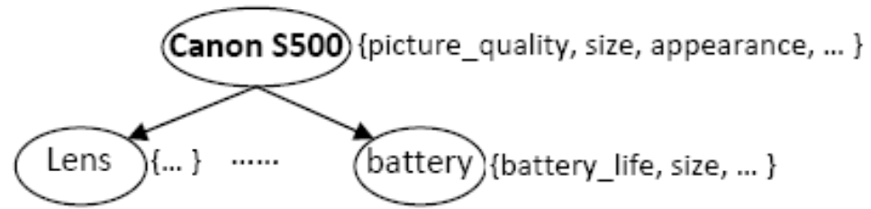
Aspect-based Sentiment Analysis
Entity and Aspect
Entity: a product, person, event, organization, or topic
Entity can be represented as a hierarchy of components and sub-components with corresponding attributes
Attributes
referred to Aspects
Components/
Sub-components

Slide 8
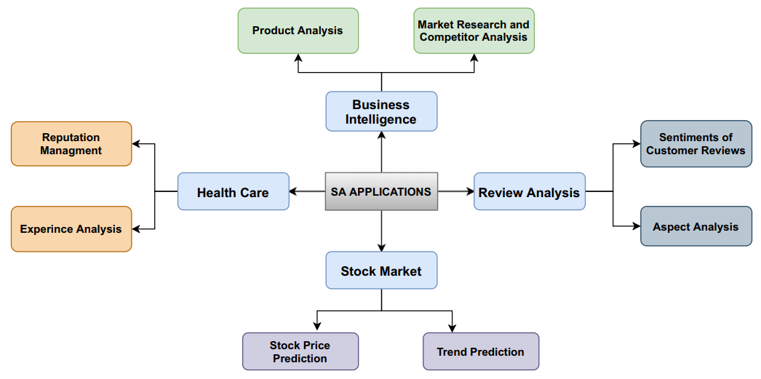
Sentiment Analysis Applications
Notes:
Business analysis: Product reviews, Market research and competitor analysis
Healthcare: For example, Twitter: collect treatment experiences, rallying support, and expanding public awareness
Stock market: analyzing all the news about the stock market and predicting the stock price trends. Data can be collected from various sources like Twitter, news articles, blogs, etc.

Slide 9
2
Sentiment Analysis Tasks

Slide 10
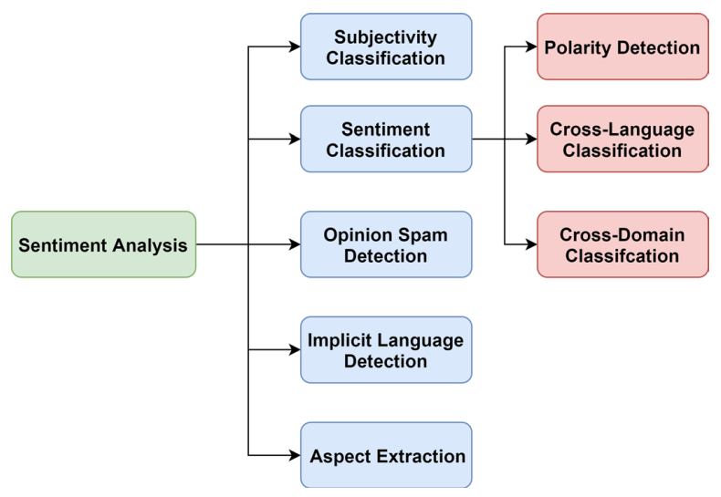
Sentiment Analysis Tasks
Subjectivity classification:
Recognizes subjective hints, emotional phrases, and subjective idea
Sentiment classification:
Polarity determination: positive, negative, (neutral)
Opinion spam detection:
Opinion spam: fake reviews, well-written comments supporting or criticizing a product for certain benefits.

Slide 11
Sentiment Analysis Tasks
Implicit language detection:
Implicit language: sarcasm, irony, and humor
flip the meaning and polarity of the sentence.
E.g.: “Brilliant, I am fired”
Aspect extraction:
Aspect-level SA includes 3 steps:
aspect extraction,
polarity classification,
and aggregation
Methods:
- Frequency-based
- Rule-based

Slide 12
Document Sentiment Classification
Classify a whole opinion document (e.g., a review) based on the overall sentiment of the opinion holder
Classes: Positive, Negative, Neutral
Neutral is often hard to detect and often ignored
Assumption: The doc is written by a single person and expresses opinion/sentiment on a single entity
Product reviews usually satisfy the assumption
Positive: 4 or 5 stars, negative: 1 or 2 stars
=> Perhaps the most widely studied problem.

Slide 13
Sentence Subjectivity & Sentiment Classification
Document-level sentiment classification is too coarse for most applications
→ So do sentence-level analysis
Assumption: a single sentiment per sentence
Not always true, so one can classify clauses instead
Usually consists of two steps:
Subjectivity classification: To identify subjective sentences
Sentiment classification of subjective sentences
positive or negative
Challenges:
Many objective sentences can imply sentiments
Many subjective sentences do not express positive or negative sentiments/opinions
E.g., “I believe he went home yesterday.”

Slide 14
Aspect-based Sentiment Analysis
Sentiment classification at both the document and sentence (or clause) levels are useful, BUT
They do not find what people liked and disliked
They do not identify the targets of opinions, i.e.,
Entities and their aspects
Without knowing targets, opinions are of limited use
→ We need to go to the entity and aspect level

Slide 15
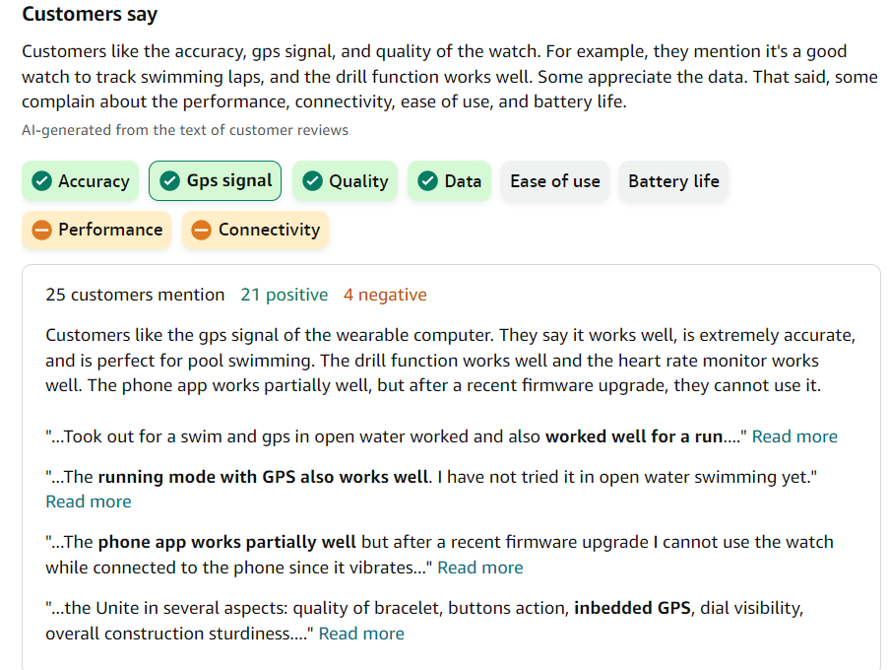
Aspect-based Sentiment Analysis (ABSA)
Most of the research is based on online reviews
For reviews, ABSA is easier because the entity (i.e., product name) is usually known
Reviewers simply express positive and negative opinions on different aspects of the entity.

Slide 16
Aspect-based Sentiment Analysis (ABSA)
Finding entities (entity set expansion)
E.g., one wants to study opinions on phones
given Motorola and Nokia, find all phone brands and models in a corpus, e.g., Samsung, Moto
Feature/Aspect extraction
Extraction may use:
frequent nouns and noun phrases
opinion and target relations: Proximity or syntactic dependency
standard IE methods: keyword extraction, NER, …
Rule-based or supervised learning

Slide 17
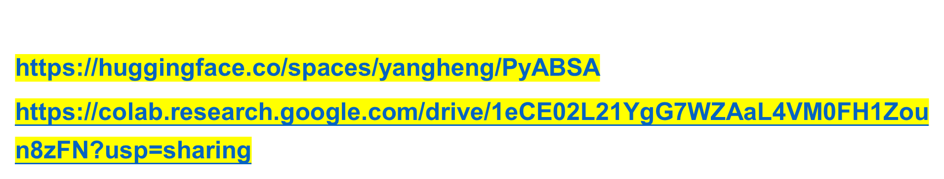
Aspect-based Sentiment Analysis (ABSA)

Slide 18
3
SA Methods and
Techniques

Slide 19
Feature selection
N-gram: Extracts unigram, bigram, and trigram based on their frequency
Emoji: Facial expression used to convey emotion
→ A useful feature
Punctuation marks: Used to highlight the force of a positive or negative remark
E.g.: exclamation mark (!!!), question mark (???)
Words in slang: frequently used to introduce a sense of humor
E.g.: “lol”, “rofl”
Negations:
- Negation words can change or reverse the polarity of the opinion and shift the meaning of a sentence → very important features
E.g.: not, cannot, neither, never, nowhere, none, etc.
They may be eliminated by stopword databases.
→ So, be cautious when using external stopword libraries.
Notes:
LOL: laugh out loud
ROFL: "rolling on the floor laughing"

Slide 20

Feature Extraction
BoW: Describes the occurrence of words in a document.
E.g.: s1= “the food was good”, s2= “the service was bad”
→ bag = {’the’, ‘food’, ‘was’, ‘service’, ‘bad’, ‘good’}
→ v1= [ 1 1 1 0 0 1 ], v2= [ 1 0 1 1 1 0 ]
TF or TF-IDF: Based on the frequency of n-gram to extract feature
→ voc = { ‘food’, ‘service’, ‘bad’, ‘good’}
→ v1= [ 1 0 0 1 ], v2= [ 0 1 1 0 ]
POS tagging: Tagging words by either nouns, verbs, pronouns, adverbs, adjectives, or prepositions
Word embedding:

Slide 21
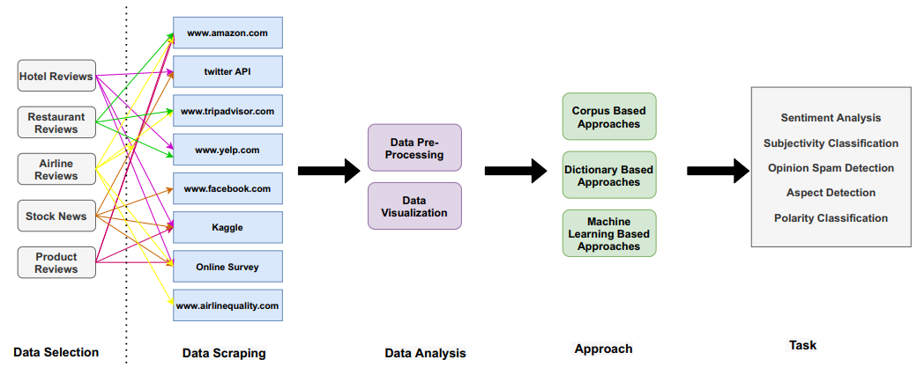
SA Methods - Workflow

Slide 22
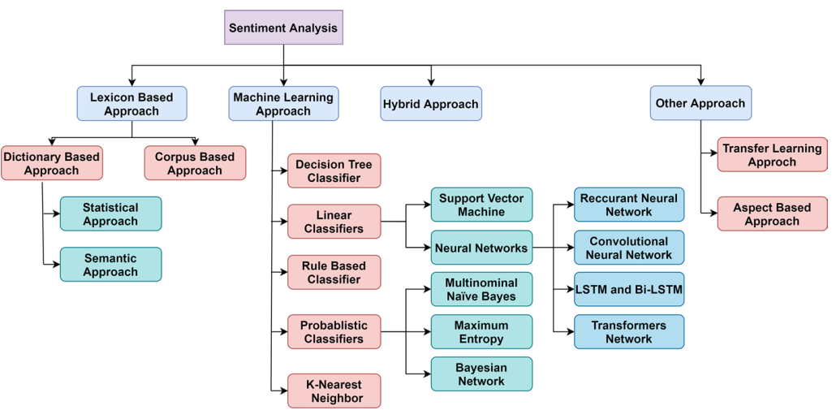
SA Methods

Slide 23
SA Methods - Lexicon Based Approach
Each token is assigned a predefined score to indicate the polarity nature of the text
For a given review, polarity scores are aggregated separately for positive, negative, and/or neutral.
Overall polarity = polarity with the highest score.
Polarity lexicon:
Positive: beautiful, wonderful, good, amazing
Negative: bad, poor, terrible, cost an arm and a leg
Pros: No training required
Cons: Domain and context dependence
A positive word in one domain or context may be negative in another
E.g., “The TV screen is too small” vs. “This camera is incredibly small”

Slide 24
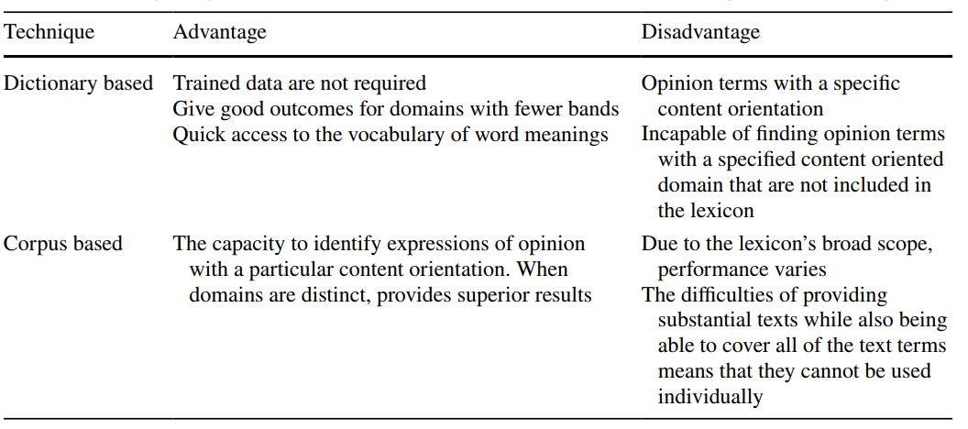
SA Methods - Lexicon Based Approach
Corpus-based methods vs. Dictionary-based methods

Slide 25
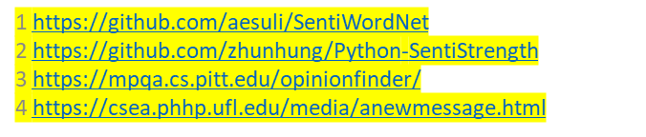
SA Methods - Lexicon Based Approach - Tools
SentiWordNet¹: assigns numerical sentiment scores to WordNet synsets that are either positive or negative
SentiStrength²: texts are categorized according to the highest positive or negative score for any constituent word
OpinionFinder System³: recognizes subjective statements automatically and highlights: holder, polarity terms…
Affective Norms for English Words (ANEW^{)4:} a collection of normative emotional ratings for English words. Rated in terms of pleasure, arousal, and dominance in order to create a standard for use in studies of emotion and attention.

Slide 26
SA Methods – Machine Learning Based Approach
Supervised learning
Requires training data to train a classifier for the SA task
Is considered as a classification problem
Common ML models:
Naive Bayes
Support vector machine (SVM)
Logistic regression
Decision tree
Radom forests
K‑nearest neighbors (KNN)
Neural Networks
Unsupervised learning
NOT require training data
Is considered as a clustering problem
Utilizes knowledge bases, ontologies, databases, and lexicons as features specified for SA
Semi-supervised learning
Needs a smaller number of labeled data for training the classifier
Leverages unlabeled data for improving the classifier.

Slide 27
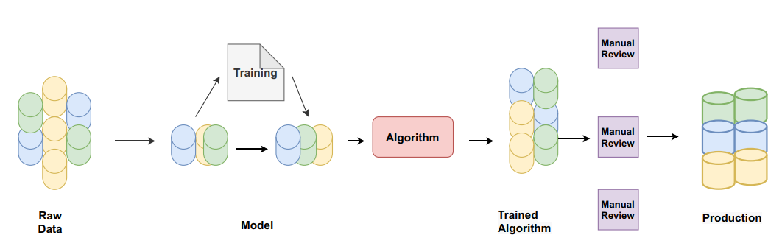
SA Methods – Machine Learning Based Approach
Supervised learning: requires training data to train a classifier for SA task

Slide 28
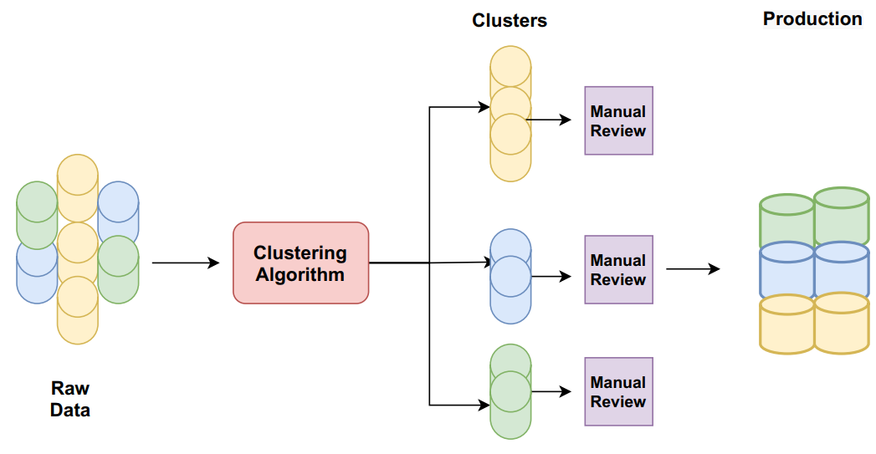
SA Methods – Machine Learning Based Approach
Unsupervised learning: NOT require training data to train ML model

Slide 29
4
Challenges in SA

Slide 30
Challenges in SA
Sarcasm:
Affected by many factors such as tone, situation, background information, …
E.g., “What a great car, it did not start the first day.”
Hard to detect
Informal writing style
Includes acronyms, emojis, slang, abbreviations, etc. that are various and evolve over time.
Grammatical and spelling errors occur frequently
Availability of training data
Some tasks such as aspect-based SA are very domain-dependent

Slide 31
Challenges in SA
Sentiment shifters
Sentiment/opinion shifters (also called valence shifters are words and phrases that can shift or change opinion orientations
Negation is the most common type.
E.g., not, never, cannot, etc.
“It hardly works.”
Degree adverbs and intensifiers:
E.g., barely, hardly, too…
Words like fail, omit, neglect, etc. behave similarly
“This camera fails to impress me.”
Modal auxiliary verbs can alter opinion orientations
E.g., would, should, could, etc.
“The brake could be improved.”

Slide 32
Challenges in SA – Aspect-based SA
Explicit and implicit aspects
Explicit aspects: Aspects explicitly mentioned as nouns or noun phrases in a sentence
E.g., “The picture quality of this phone is great.”
Implicit aspects: Aspects not explicitly mentioned in a sentence but are implied
E.g., “This car is so expensive.” => implies “price”
E.g., This phone will not easily fit in a pocket.” => implies “size”
E.g., Included 16MB is stingy” => implies “memory volume”
Adjectives and adverbs are perhaps the most common type of implicit aspects
“expensive” => aspect “price”, “beautiful” => aspect “appearance”, “heavy”=> aspect “weight”
Although manual mapping is possible, in different contexts, the meaning can be different.
→ Not much work has been done on mining or mapping implicit aspects

Slide 33
Summary
Sentiment analysis has many sub-problems
Despite the challenges, applications are flourishing
Building a reasonably accurate domain-specific system is possible

Slide 34
5
SA with Python

Slide 35
Thank you

